Slide 1
Unit 6:
Mobile Marketing

Slide 2
Introduction to Lecturer
Digital Marketing Manager, Javra Software B.V – Netherlands, Portugal, Nepal
Certified Digital Marketing Trainer, Upskills Nepal
MBA Faculty Lecturer, Kasthamandap College of Management(PU)
MBA Faculty Lecturer, SANN International College(PU)
BBA Faculty Lecturer, Cosmos College of Management and Technology(PU)
Nutan Regmi [MBA, Bsc. Computer Science & IT]

Slide 3
1. Mobile Platforms
Definition:
A mobile platform refers to the combination of the operating system (OS) and hardware that enables mobile applications and services to function. Understanding mobile platforms is essential for app developers and marketers, as platform-specific strategies impact the user experience, engagement, and overall marketing effectiveness.
Key Mobile Platforms:
1. iOS (Apple)
iOS is Apple's proprietary mobile operating system, designed for iPhones, iPads, and iPods.
Known for its high security, smooth user experience, and premium user base.
Developers must adhere to Apple's App Store guidelines, which include strict privacy policies and quality control.
Exclusive Apple ecosystem features such as iMessage, AirDrop, and Apple Pay enhance user engagement.
Marketers targeting iOS users often focus on premium products and services due to the higher spending habits of Apple users.

Slide 4
2. Android (Google)
Android is the most widely used mobile OS worldwide, offering flexibility and open-source customization.
It supports a wide range of devices from various manufacturers (Samsung, OnePlus, Google Pixel, etc.).
Due to fragmentation across different versions and devices, testing and optimization for Android apps can be complex.
The Google Play Store has a more flexible approval process compared to Apple's App Store, making app launches quicker.
Android marketing strategies often include in-app advertising, Google Ads, and app localization to reach a global audience.
3. Other Platforms
KaiOS: Used in feature phones, particularly in emerging markets where smartphone penetration is still growing.
HarmonyOS (Huawei): A rising alternative to Android, particularly in China, following Huawei’s restrictions on using Google services.
Windows Phone (Discontinued): Microsoft’s attempt at a mobile OS, which failed due to lack of app support and developer interest.

Slide 5
2. Mobile Web and Applications
Mobile Web:
The mobile web consists of websites and web applications designed for mobile devices. These sites must be optimized for smaller screens and touch-based navigation.
Best Practices for Mobile Web Optimization:
Responsive Design: Ensures that the website adjusts dynamically based on screen size and orientation.
Fast Loading Speeds: Minimize loading time using compressed images, efficient coding, and caching strategies.
User-Friendly Navigation: Implement clear call-to-actions (CTAs), larger touch-friendly buttons, and minimalistic menus.
SEO for Mobile Search: Use mobile-first indexing and optimize content for voice search and local searches.

Slide 6
Tools for Mobile Web Optimization:
Google’s Mobile-Friendly Test: Helps analyze mobile usability.
Bootstrap Framework: Enables responsive web development.
AMP (Accelerated Mobile Pages): Google’s initiative to make web pages load faster on mobile devices.

Slide 7
Mobile Applications:
Mobile apps provide a more interactive and personalized experience than mobile websites. There are three main types of mobile applications:
1. Native Apps
Built specifically for a particular platform (iOS or Android) using platform-specific programming languages (Swift for iOS, Kotlin/Java for Android).
Offer superior performance and access to device features such as GPS, camera, and notifications.
Examples: Instagram, WhatsApp, Spotify.
2. Hybrid Apps
Developed using web technologies like HTML, CSS, and JavaScript but wrapped in a native shell.
Can function across multiple platforms with a single codebase.
Examples: Applications built using frameworks like React Native, Ionic, and Flutter.

Slide 8
3. Progressive Web Apps (PWAs)
Web applications that function like native apps but are accessed through a web browser.
Provide offline functionality and push notifications.
Examples: Starbucks PWA, Twitter Lite.
Mobile Marketing Strategies for Apps:
App Store Optimization (ASO): Enhancing app visibility in app stores using keyword optimization, ratings, and descriptions.
Push Notifications: Sending timely messages to users to increase engagement.
In-App Advertising: Monetizing free apps through ads.
Social Media Integration: Encouraging users to share app-related content on social platforms.

Slide 9
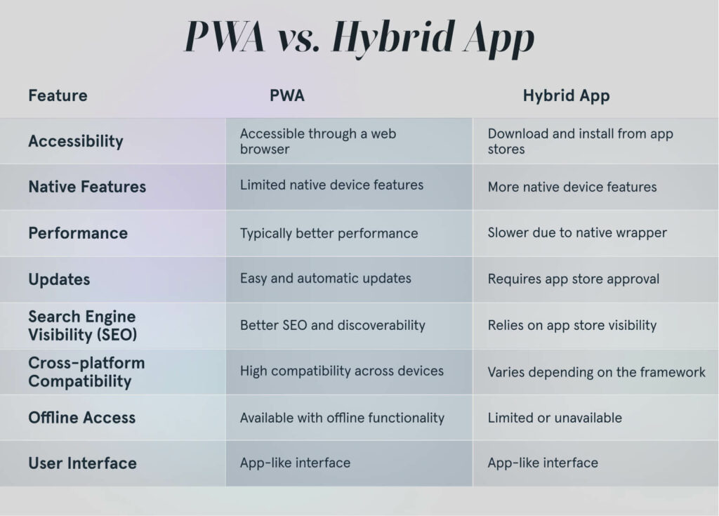

Slide 10
3. Mobile Commerce and Showrooming
Mobile Commerce (m-Commerce):
Mobile commerce refers to buying and selling goods/services via mobile devices. It includes mobile shopping, banking, and digital transactions.
Key Aspects of Mobile Commerce:
Mobile Shopping Apps: E-commerce giants like Amazon, eBay, and Shopify rely on mobile applications for seamless shopping experiences.
Mobile Payment Systems: Digital wallets such as Apple Pay, Google Pay, and PayPal provide secure and convenient transactions.
Mobile-Optimized E-commerce Websites: Ensuring that e-commerce platforms are mobile-friendly enhances user retention and conversions.

Slide 11
Showrooming:
Showrooming is the practice of visiting physical stores to inspect products before purchasing them online, often at a lower price.
Impact of Showrooming on Retailers:
Physical stores face competition from online marketplaces.
Consumers use mobile devices to compare prices in real time.
Counter-Strategies for Showrooming:
Price Matching: Retailers offer competitive pricing to discourage customers from buying elsewhere.
Exclusive In-Store Promotions: Providing discounts or loyalty rewards for in-store purchases.
Enhanced Customer Experience: Offering interactive store displays, expert assistance, and product demonstrations.
Mobile Apps with Augmented Reality (AR): Allowing users to visualize products before purchasing.

Slide 12
4. Location-Based Services (LBS)
Definition:
Location-based services (LBS) use mobile device location data to deliver relevant content, advertisements, or offers to users.
Key Technologies Enabling LBS:
GPS (Global Positioning System): Uses satellites to determine exact location.
Wi-Fi Triangulation: Determines location based on proximity to Wi-Fi networks.
Cellular Tower Triangulation: Estimates location using signals from nearby cell towers.

Slide 13
Applications of Location-Based Services:
Mapping & Navigation: Google Maps, Apple Maps, Waze.
Location-Based Advertising: Displaying targeted ads based on a user’s real-time location.
Proximity Marketing: Sending promotions when users are near a specific location.
Check-In Services: Social media platforms like Foursquare encourage users to check in at locations.
Privacy Considerations in LBS:
User Consent: Businesses must obtain explicit permission before collecting location data.
Data Security: Implement encryption and anonymization to protect location data.
Transparency: Clearly communicate how location data will be used.

Slide 14
Mobile marketing is an evolving field that integrates mobile platforms, applications, e-commerce strategies, and location-based services to enhance user engagement and drive business growth.
Marketers must adapt to emerging trends while prioritizing user privacy and security for long-term success.

